Slide 1
Inheritance
Inheritance is one of the three foundation principles (Encapsulation, Polymorphism and Inheritance) of object-oriented programming because it allows the creation of hierarchical classifications.
Using inheritance, we can create a general class that defines traits common to a set of related items.
This class can then be inherited by other, more specific classes, each adding those things that are unique to it.

Slide 2
Inheritance
In the language of Java, a class that is inherited is called a superclass.
The class that does the inheriting is called a subclass.

Slide 3

Inheritance
Java supports inheritance by allowing one class to incorporate another class into its declaration.
This is done by using the extends keyword. Thus, the subclass adds to (extends) the superclass.

Slide 4
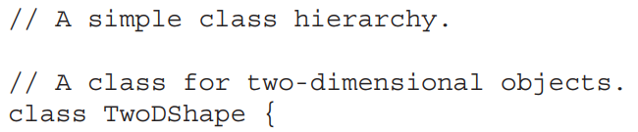
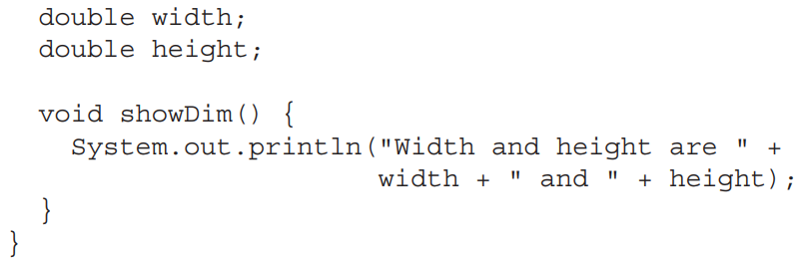
Inheritance

Slide 5
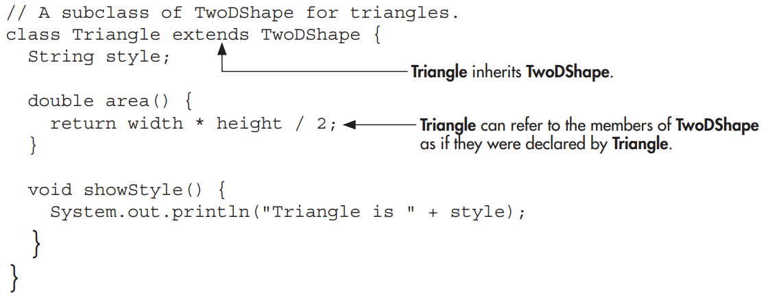
Inheritance

Slide 6
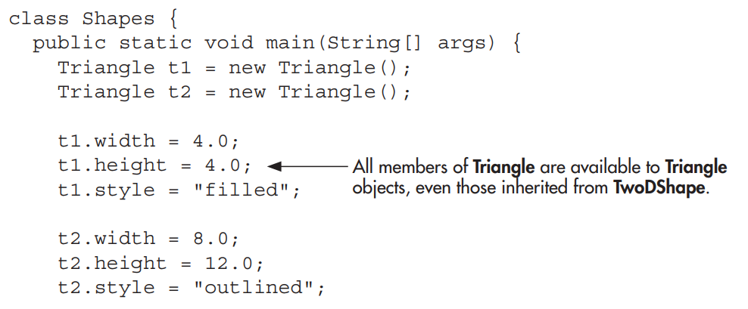
Inheritance

Slide 7
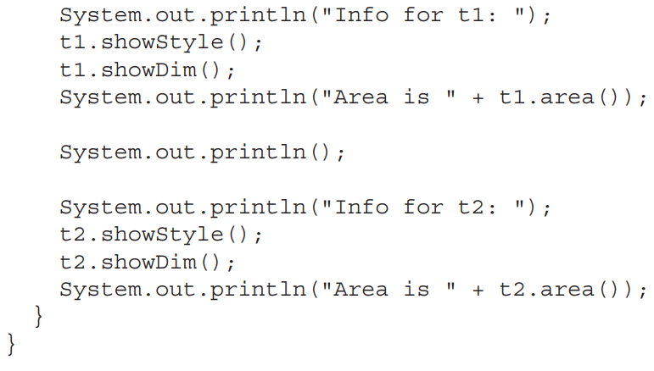
Inheritance

Slide 8
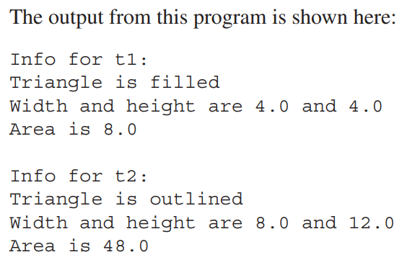
Inheritance

Slide 9
Inheritance
Even though TwoDShape is a superclass for Triangle, it is also a completely independent, stand-alone class.
Being a superclass for a subclass does not mean that the superclass cannot be used by itself.

Slide 10
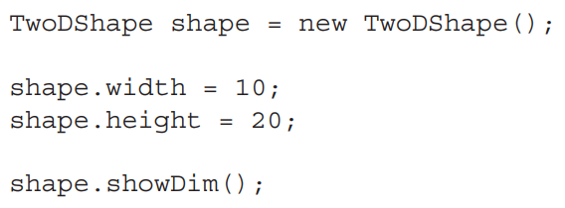
Inheritance
For example, the following is perfectly valid:
Of course, an object of TwoDShape has no knowledge of or access to any subclasses of TwoDShape.

Slide 11
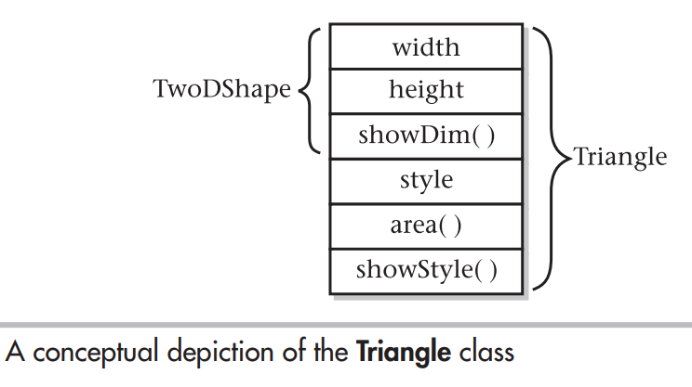
Inheritance

Slide 12
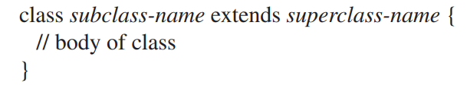
Inheritance
The general form of a class declaration that inherits a superclass is shown here:

Slide 13
Inheritance
we can specify only one superclass for any subclass that we create.
Java does not support the inheritance of multiple superclasses into a single subclass.
(This differs from C++, in which you can inherit multiple base classes).

Slide 14
Inheritance
A major advantage of inheritance is that once you have created a superclass that defines the attributes common to a set of objects, it can be used to create any number of more specific subclasses.
Each subclass can precisely tailor its own classification.

Slide 15
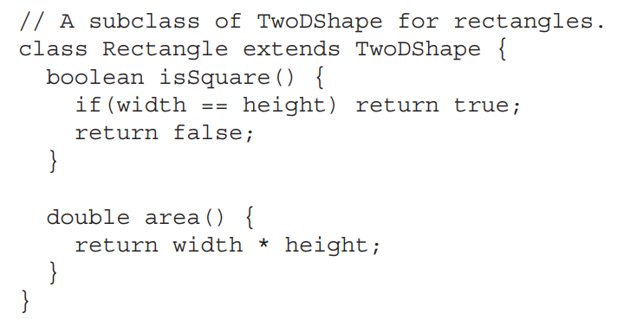
Inheritance
For example, here is another subclass of TwoDShape that encapsulates rectangles:

Slide 16
Inheritance
As you know, an instance variable of a class will be declared private to prevent its unauthorized use or tampering.
Even though a subclass includes all of the members of its superclass, it cannot access those members of the superclass that have been declared private.

Slide 17
Inheritance
For example, if, as shown here, width and height are made private in TwoDShape, then Triangle will not be able to access them.

Slide 18
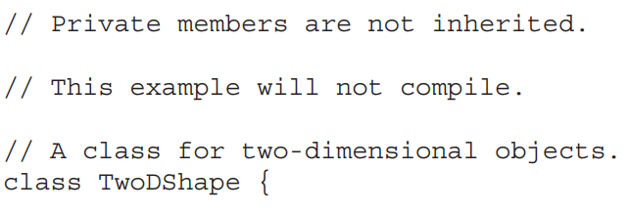
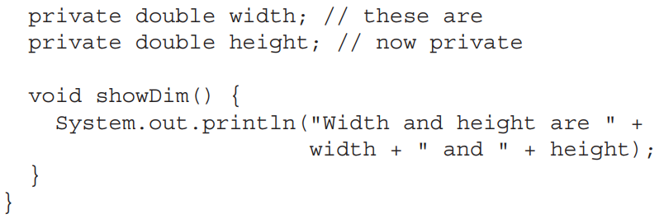
Inheritance

Slide 19
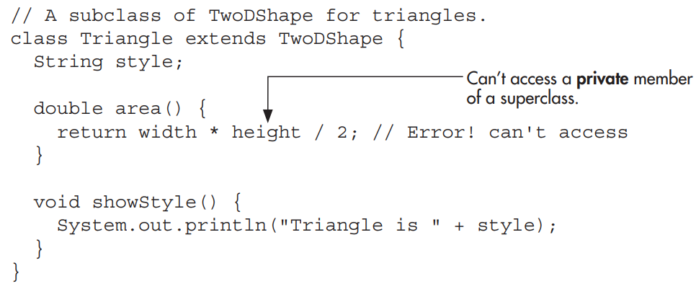
Inheritance

Slide 20
Inheritance
Java programmers typically use accessor methods to provide access to the private members of a class.
Here is a rewrite of the TwoDShape and Triangle classes that uses methods to access the private instance variables width and height:

Slide 21
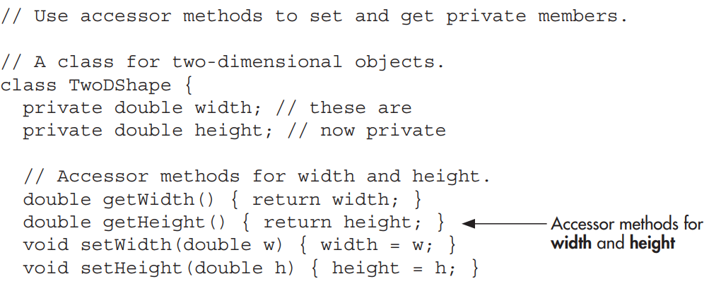
Inheritance

Slide 22
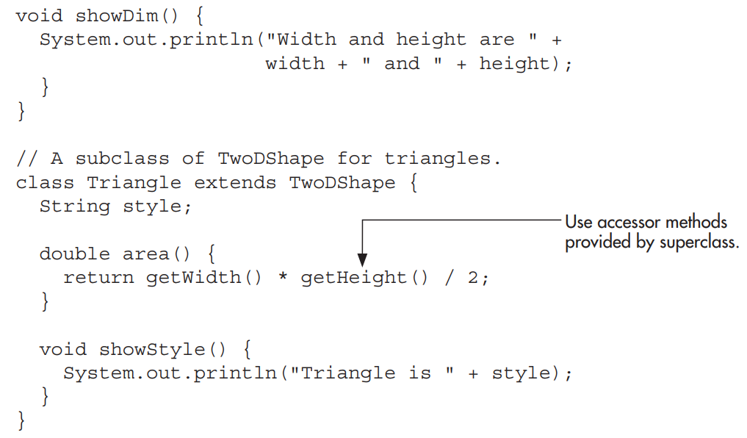
Inheritance

Slide 23
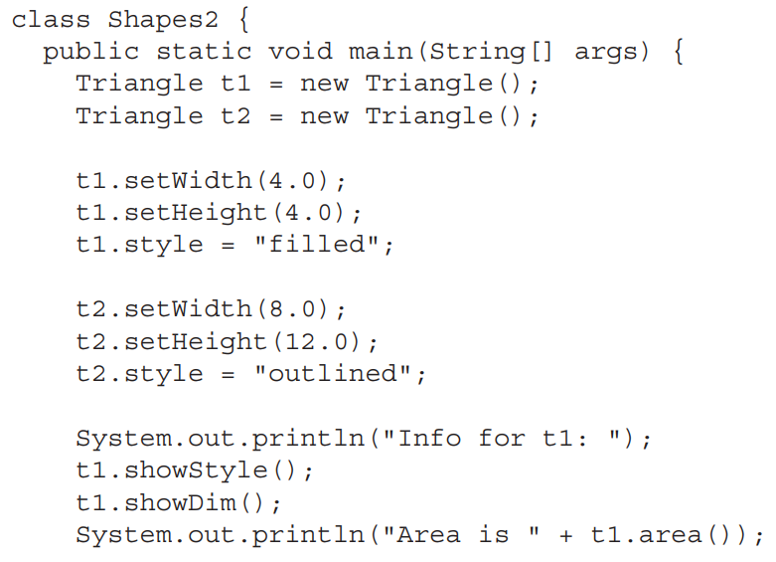
Inheritance

Slide 24
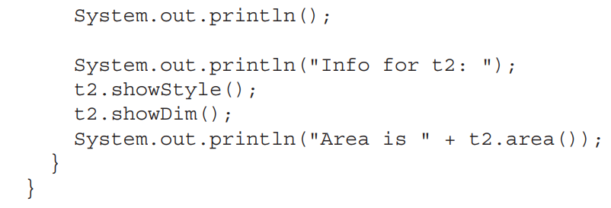
Inheritance

